Slide 1
Pneumonia Detection from Chest X-Ray Images
By
A Jyotishwara Prasad and N Mukesh
(Geetanjali College of Engineering and Technology)
E Pravallika , P Saileswar Reddy and K R G Deepak Teja
(JNTUA College of Engineering, Pulivendula)

Slide 2
Problem Statement:
To detect Pneumonia clouds in scanned Chest X-Rays of pediatric patients using CNN( Convolutional Neural Networks).
Domain : Artificial Intelligence
Sub-Domain : Image Recognition
Techniques : Convolutional Neural Networks
Tools/Libraries
Languages : Python
Tools/IDE : Anaconda
Libraries : keras, tensorflow, pillow, matplotlib

Slide 3
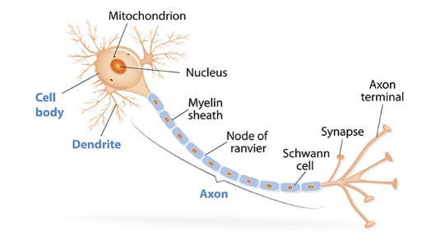
Technical Details
Artificial intelligence (AI) is the branch of computer science which aims to create intelligence machines.
Image processing is a method to perform some operations on an image, in order to get an enhanced image or to extract some useful information from it.
A Neuron (also called nerve cell) is a cell that carries electrical impulses. Neurons are the basic units of the nervous system. Every neuron is made of a cell body (also called a soma), dendrites and an axon. Dendrites and axons are nerve fibers

Slide 4
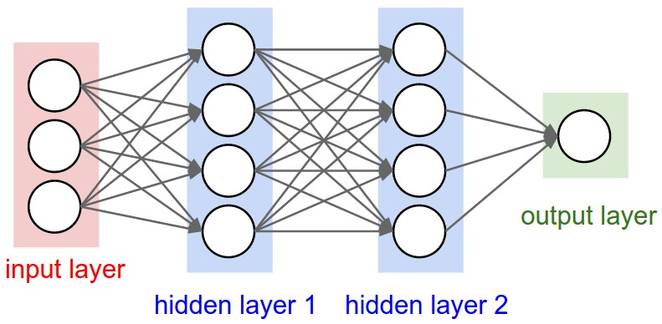
A Neural Network is a network or circuit of neurons, or in a modern sense, an artificial neural network, composed of artificial neurons or nodes for solving Artificial Intelligence (AI) problems.

Slide 5
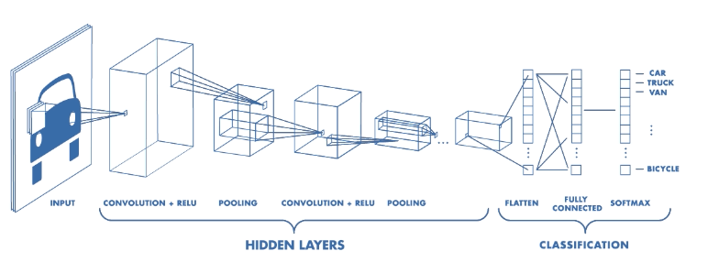
Convolutional Neural Networks
A Convolutional Neural Network (CNN) is a class of deep neural networks, most commonly applied to analyzing visual imagery.
Building Blocks
Convolution Layer
Pooling Layer
RELU Layer
Full Connection

Slide 6
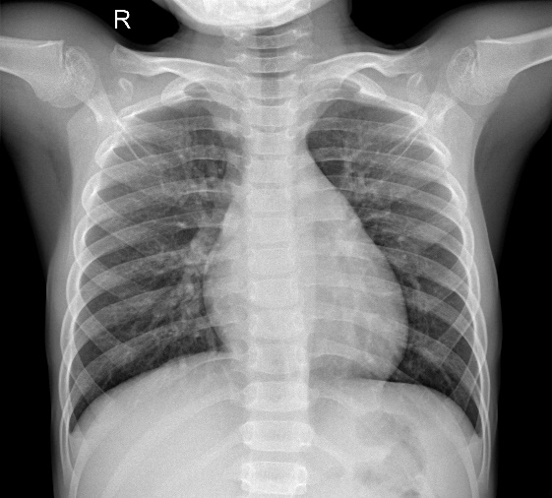
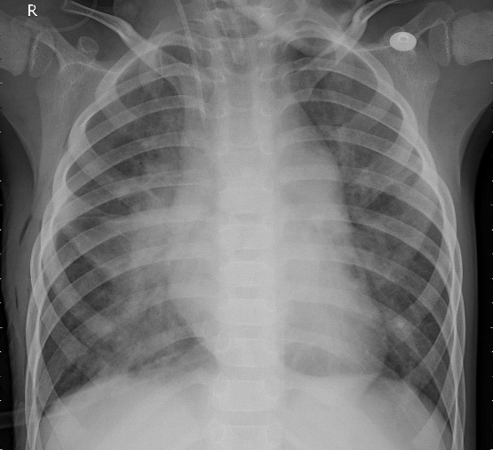
Dataset Details
Dataset Name : chest-xray-pneumonia
Dataset source : https://www.kaggle.com/paultimothymooney/chest-xray-pneumonia
Chest X-ray images of pediatric patients of one to five years old were selected as part of patients’ routine clinical care and grouped in this dataset.
The Dataset is organized into three folders (train, test and val) and contains two subfolders (Pneumonia/Normal) for each image category.
X-ray of Normal Person
X-ray of Pneumonia Infected person

Slide 7
Libraries
Keras
Open-source neural-network library written in Python.
Capable of running on top of TensorFlow, Microsoft Cognitive Toolkit, Theano, or PlaidML.
It focuses on being user friendly, modular, and extensible.
TensorFlow
Free and open-source software library for dataflow and differentiable programming across a range of tasks.
Also used for machine learning applications such as neural networks.

Slide 8
Pillow
Python Imaging Library (abbreviated as PIL) (in newer versions known as Pillow) is a free library for the Python programming language that adds support for opening, manipulating, and saving many different image file formats.
It is available for Windows, Mac OS X and Linux.
Matplotlib
A plotting library for the Python programming language and its numerical mathematics extension NumPy.
Provides an object-oriented API for embedding plots into applications

Slide 9
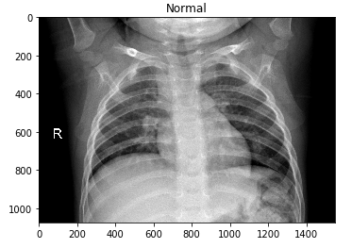
Loading Image Path
img_n = load_img('G:/AI/chest-xray-pneumonia/chest_xray/chest_xray/train/NORMAL/IM-0234-0001.jpeg')
plt.imshow(img_n)
plt.title("Normal")
plt.show()
Output

Slide 10
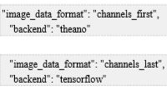
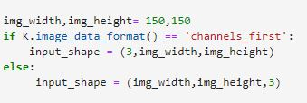
Functions
image_data_format()

Slide 11
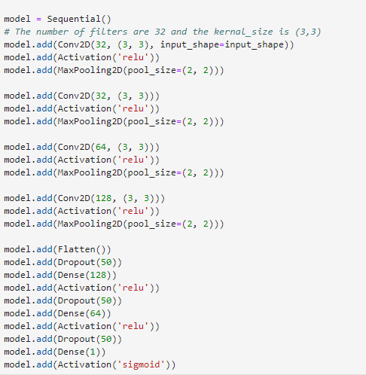

Slide 12

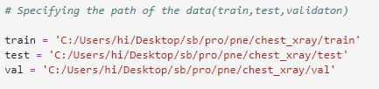

Slide 13
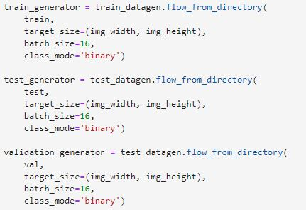


Slide 14
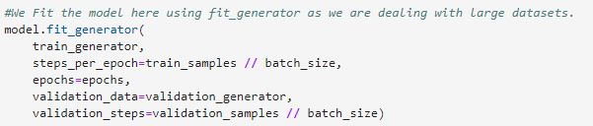
fit_generator()
In fit_generator() , you don't pass the x and y directly, instead they come from a generator.
Generator is used when you want to avoid duplicate data when using multiprocessing.
keras’ fit_generator() function is used :
If datasets are often too large to fit into memory.
To avoid overfitting and increase the ability of our model.

Slide 15

evaluate_generator()
Evaluates the model on a data generator.
Predicts the accuracy of test data

Slide 16
Output
Accuracy for train_data : 95.80%
Loss for train_data : 13.14 %
Accuracy of Test_Data : 90.31%
Further Enhancements:
We can compile the model at more number of epochs.
Hyper-parameter Tuning(There are a lot of parameters that we can play with).
Use of much more deeper architectures.

Slide 17
Application
Used in automat diagnostics of medical images
Conclusion
Thus a model was built for detecting pneumonia from scanned X-ray images by using CNN with
an accuracy of 95% (on train_data) and an accuracy of 90% (on test_data) approximately.

